Slide 1





Workplace Intelligence
Solution Accelerator
Discover factors that influence workplace productivity and engagement
Businesses are using the power of data to transform their organization's systems and processes, but many overlook that impact of applying the same principles to its workforce.
The Workplace Intelligence Solution Accelerator can help. It leverages machine learning and big data analytics to bring together and transform your data, allowing you to build and deploy a machine learning model to easily identify factors that influence productivity and engagement.
Benefits
Easily launch your solution using pre-built, pre-configured GitHub code and architecture.
Gain more collaboration time, improve your meetings, and share knowledge.
Identify work habits or distractions that reduce your team's ability to focus on core priorities.
Determine effective means to improve employees' work-life balance.
Reduce development time with end-to-end unified analytics via Azure Synapse Analytics, Azure Machine Learning, and Power BI.
Quickly analyze data to determine which factors impact workforce efficiency.
Inspired employees are 125% more productive than an employee who is merely satisfied.
How it works
Azure Synapse Analytics leverages AI and Power BI in a dashboard that provides visibility into work habit data from Microsoft 365 to help your team optimize efficiency, improve collaboration, and maintain health work/life balance.
Native Office 365 data
Business context (DevOps)
Control and governance
Insights and change
Customer challenges
Organizations across many industries face complex challenges that need to be solved with better visibility.
Customer wants to create, manage, and track targeted change management plans to help reduce meeting load and increase focus time.
Customer wants to use research-based behavioral insights and workflow information to learn how the organization currently gets work done and how to maintain or change work patterns over time.
Customer wants to keep valued employees in business-critical rolls and keep internal leadership pipeline full. Customer wants to increase employee satisfaction and engagement without reducing productivity.
©2021 Microsoft. All rights reserved.

Slide 2
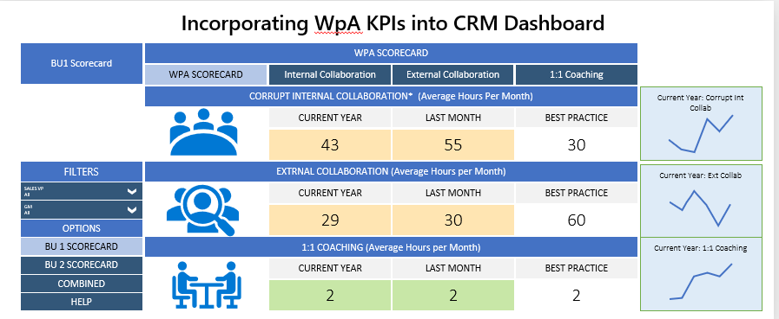
Learning by doing – Microsoft insights pilot
Microsoft wanted to uncover what impacts some of its work/life balance polices were having on the employees and on productivity. To unlock those insights, doctor became patient, piloting a project to use Microsoft’s Workplace Analytics to analyze behavior data from Microsoft 365 to gain insight into how their teams were spending their time and what collaboration patterns were driving business outcomes. As a result, the team was able to clearly understand how their actions impacted productivity and identified potential opportunities to spend its time in more effective ways.
Incorporating WpA KPIs into CRM Dashboard
Incorporating WpA KPIs into CRM Dashboard
Accelerate your journey
Move from kick-off to deployment in just a few weeks.
Kick-off
Proof of value
MVP & Deployment
Learn more about the Workplace Intelligence Solution Accelerator and see a demo.
Solution code walk-through and prototype creation for customer testing.
Minimum Viable Product (MVP) is built and deployed for the customer with support of the technical specialists (CSA) and Partners.
With demo data, create your MVP in less than a day
With your custom data and a prep session, create your MVP in 2-5 weeks
How to get started
Contact your Microsoft specialist for a demo and to discuss prerequisites, next steps, and your questions.
©2021 Microsoft. All rights reserved.

